Slide 1

Lab -1
Lab Introduction
Instructor : Dr. AALWAHAB DHULFIQAR
Advisor : Dr. Tejfel Mate
What you will learn:
Who we are.
Setup the lab environment
Semester schedule.
The grade system.
What we expect from you.

Slide 2
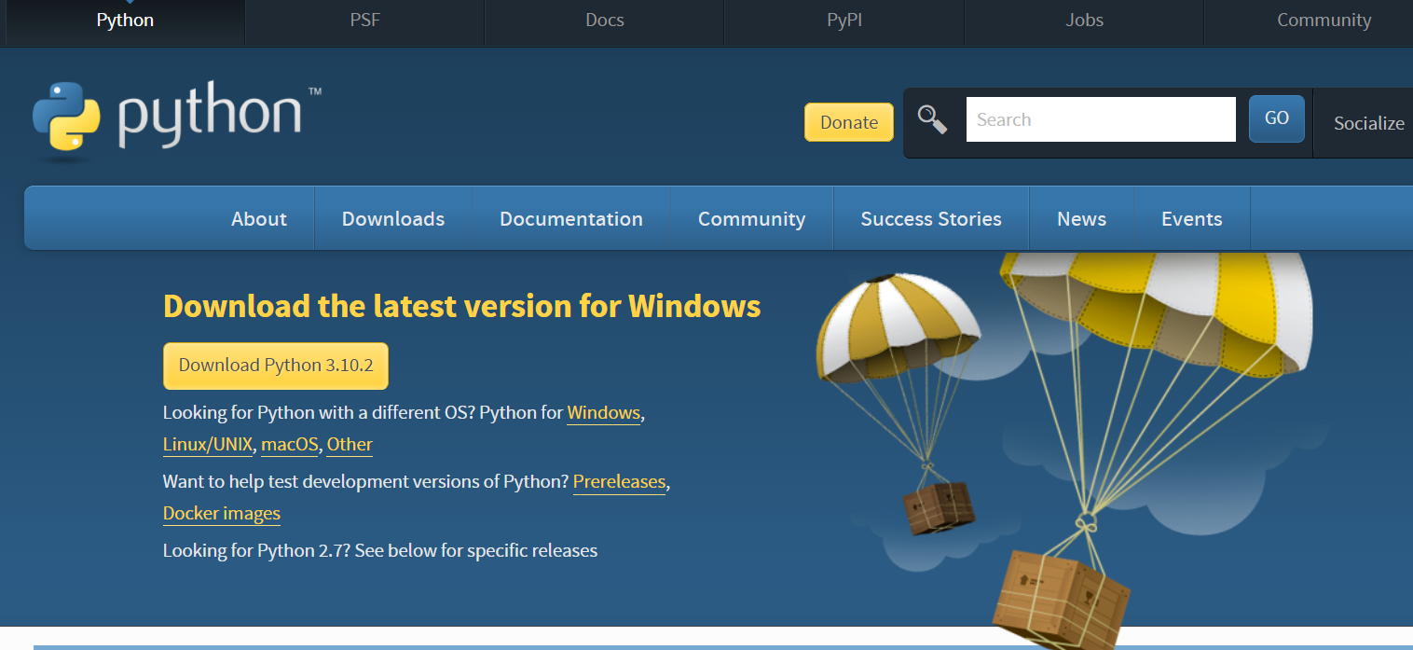
Setup the lab environment (Part-1)
Windows
https://www.python.org/downloads/
Notes:
https://www.youtube.com/watch?v=lS3NH-8iGao

Slide 3


Setup the lab environment (Part-2)
Windows
Link to be given later
https://projects.raspberrypi.org/en/projects/raspberry-pi-setting-up

Slide 4

The grade system
Lectures (Chapters exams on BigData)
labs
Exam
Warmups
Attendance + activities +
2 Assignments
Exam (To be specified in December/ January)

Slide 5

What we expect from you.
1- Attend.
2- Do the labs.
3- Follow the instructions.
4- Be active by sharing your opinion.
5- Discuss/ answer question asked by you colleagues.
6- Feedback me about the lectures and the labs.
Any questions / inquiries
Consultation hours
Thursdays (18:00-20:00)

Slide 6
See you in the Next week ☺

